Slide 1


Strengthening Law Enforcement and Reducing Elephant Poaching in Yankari Game Reserve, Nigeria
Final Report to the UNEP African Elephant Fund
Fidelis Omeni
Deputy Director, Wildlife Management,
Federal Ministry of Environment
November 2014

Slide 2
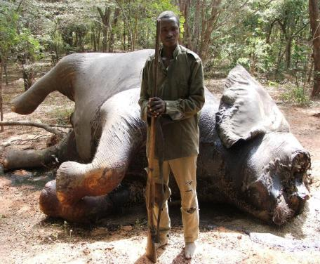
Introduction
Grant Award $14,850
Grant Period: Jan 2013-Jan 2014
Project supervised by Federal Ministry of Environment and the Wildlife Conservation Society (WCS)

Slide 3
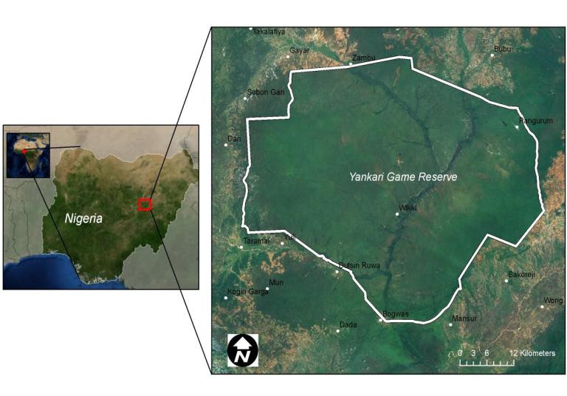
Location of Yankari Game Reserve

Slide 4
Yankari Game Reserve
Size 2,228km²
Elephant population estimated at 300-350
Managed by Bauchi State Government (BASG) since 2006
BASG has very low capacity & limited commitment –relies on WCS
WCS supporting anti-poaching patrols since 2009 with limited funds.
Since 2014 WCS officially manages the ranger program on behalf of BASG.
Elephant poachers increasingly determined, armed and violent.
In 2012-2013 three rangers were killed by poachers.
Protection is constrained due to the lack of firearms, vehicles and training.
Corruption among rangers and government officials remains an issue.
Unsupervised rangers on periphery of reserve also a threat
Informant network and bonus system has increased number of arrests of elephant poachers and seizures of ivory.

Slide 5
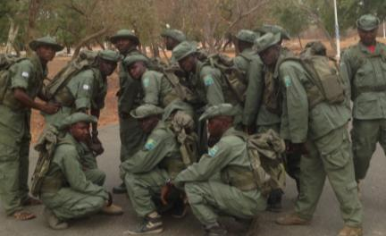
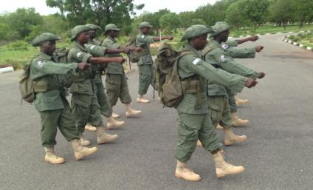
Output 1: All Yankari Rangers Provided with Essential Field Equipment
90 uniforms & patches
90 bush hats
90 rucsacs
90 boots
90 rain ponchos
90 water bottles

Slide 6
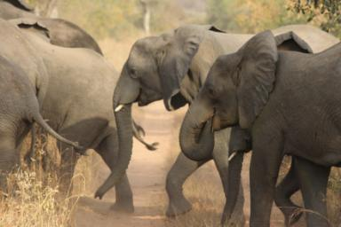
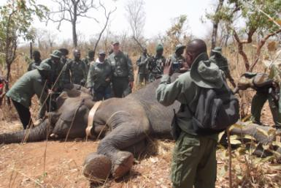
Output 2: A Ceremony to Formally Hand-Over the Equipment Organized
Formal ceremony not done due to budget constraints
Levels of awareness raised through newspaper articles and creation of a Facebook page

Slide 7
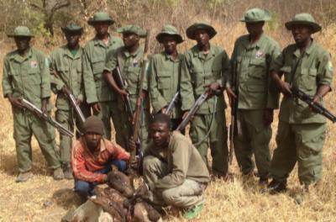
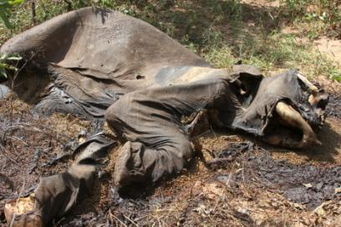
Output 3: Monthly Reports Produced
Monthly reports produced and distributed to BASG
Quarterly reports posted online www.wcsnigeria.org and distributed to BASG and other stakeholders
Annual report planned.

Slide 8
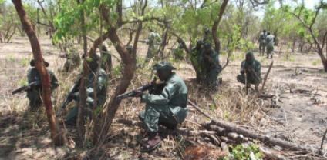
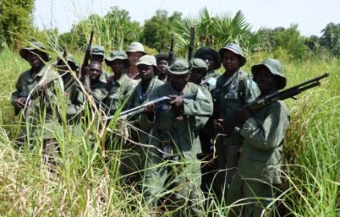
Output 4: Evaluation Report Produced
Evaluation report will be produced in 2015.
Boots and uniforms significantly raised morale and effectiveness in field.
Revitalized patrols arrested a number of elephant poachers and ivory dealers.
Number of elephant carcasses seen per year has reduced.

Slide 9
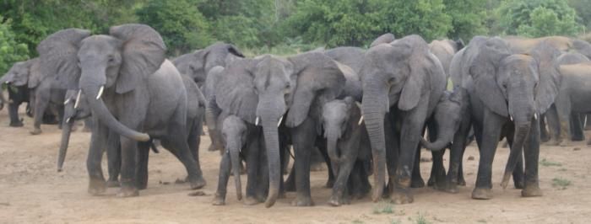
Next Steps
Funding situation is critical: field rations, camping allowances and fuel. Purchase of additional vehicles and firearms.
Satellite collaring of additional 2 elephants with NC Zoo.
Restart the PowerChute program for elephant monitoring and law enforcement.
Implement SMART, ensure compatability with existing CyberTracker program.
Address issue of human-elephant conflict.
Training of rangers and rehabilitation of road network.

